Slide 1
COVID-19 Vaccine Access for People With Disabilities
Priya Chidambaram
Senior Policy Analyst, Program On Medicaid and the Uninsured
7/1/2021

Slide 2
Presentation Overview
COVID-19’s Impact on Nonelderly Adults with Disabilities
New CMS Vaccine Reporting/Education Rules
The Intersection of Medicaid and Olmstead
Medicaid’s Role In Reducing Institutional Bias
Medicaid Waiver Waiting Lists and Other Utilization Limits
Looking Ahead

Slide 3
COVID-19 Cases and Deaths In LTSS Settings that Primarily Serve Nonelderly Adults With Disabilities
What Types of Settings Serving People with Disabilities Do States Report Data For?*
WA
VT
ME
MT
ND
NH
OR
MN
NY
MA
ID
SD
WI
MI
RI
WY
PA
CT
NE
IA
NJ
IN
OH
DE
NV
UT
IL
WV
MD
HCBS Settings (8 states)
CA
CO
MO
VA
DC
KS
KY
TN
NC
Institutional Settings (8 states)
AZ
NM
OK
AR
SC
AK
MS
AL
GA
HCBS & Institutional
(14 states + DC)
TX
LA
FL
HI
No Settings (20 states)
NOTES: Data was collected on 2/11/2021. Data includes both resident and staff cases and deaths. HCBS= home and community-based services. *Not all states report all settings within each category type. HCBS settings may include group homes, personal care homes, adult day/foster care, and other home and community-based settings. HCBS settings exclude assisted living facilities. Institutional settings may include ICFs, mental health facilities, substance use treatment centers, psychiatric hospitals, and other institutional settings. Institutional settings exclude nursing homes. See Appendix Table 1 for more details.
SOURCE: KFF review of state-reported data on cases and deaths in settings serving people with disabilities.

Slide 4
What else is known about COVID-19 among people with disabilities?
Nonelderly PWD who receive LTSS in settings other than nursing homes face similar COVID-19 risk factors compared to people in nursing homes
Nonelderly PWD who are members of racial or ethnic minority groups are disproportionately affected by COVID-19
Nonelderly PWD who rely on LTSS to meet daily needs also risk experiencing adverse health outcomes due to interruptions in care caused by the pandemic
Direct care workers who provide LTSS to PWD outside of nursing homes also face increased risks from COVID-19, like their nursing home counterparts.
SOURCE: KFF, COVID-19 Vaccine Access for People with Disabilities (March 2021)

Slide 5
How were people with disabilities reflected in state vaccine prioritization plans?
Some plans prioritized people with disabilities explicitly while others prioritized people with high-risk medical conditions
Some plans split people with disabilities into different priority groups based on age or type of disability
All plans included people in nursing homes in Phase 1a, and most included ALFs. The few plans that mentioned other LTSS settings did not typically place them at the same priority level as nursing homes.
Few plans explicitly mentioned direct care workers who provide LTSS in settings other than nursing homes
SOURCE: KFF, COVID-19 Vaccine Access for People with Disabilities (March 2021)

Slide 6
Which Long-Term Care Settings are Subject to New COVID Vaccine Reporting and Education Rules?
Nursing Homes
Must report vaccine & therapeutics data to CDC weekly
ICF/IIDs
Not required to report vaccine & therapeutics data to CDC
Inpatient Behav.
Not required to report vaccine & therapeutics data to CDC
Must educate & offer vaccine to residents & staff
Community-Based Settings
Not required to report vaccine & therapeutics data to CDC
Not required to educate or offer vaccine to residents & staff
Not required to educate or offer vaccine to residents & staff
Must educate & offer vaccine to residents & staff
NOTES: Nursing homes include Medicare skilled nursing facilities and Medicaid nursing facilities. ICF/IID = intermediate care facilities for individuals with intellectual/developmental disabilities. Inpatient behavioral health facilities include inpatient psychiatric hospitals, forensic hospitals, and psychiatric residential treatment facilities. Community-based settings include settings where Medicaid-funded home & community-based services are provided, such as assisted living facilities, group homes, adult foster care homes, and supervised apartments.
SOURCE: 86 Fed. Reg. 26306-26336 (May 13, 2021).

Slide 7
The Intersection of Medicaid and Olmstead
Olmstead vs. L.C.: SCOTUS held that unjustified segregation of persons with disabilities constitutes discrimination in violation of the Americans with Disabilities Act (ADA). States have a community integration obligation when serving people with disabilities.
Olmstead does not change or interpret federal Medicaid law.
However, Medicaid plays a key role in community integration as the major payer for long-term services and supports (LTSS), including the home and community-based services (HCBS) on which people with disabilities rely to live independently in the community.

Slide 8
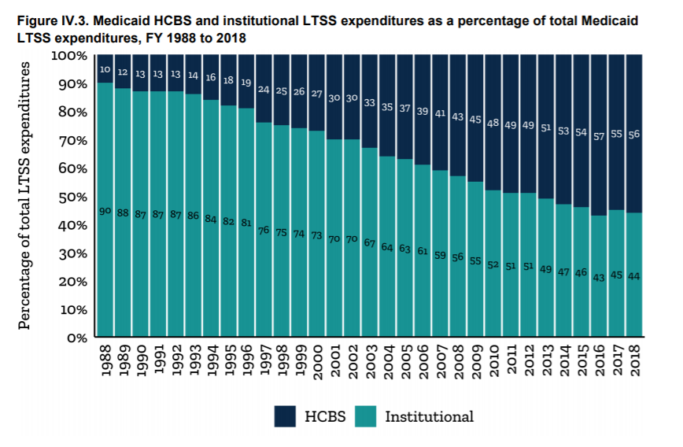
Medicaid’s Role in Reducing Institutional Bias: Spending on Long-Term Services and Supports
NOTE: Total LTSS expenditures include spending on residential care facilities, nursing homes, home health services, and home and community-based waiver services. Expenditures also include spending on ambulance providers and some post-acute care. This chart does not include Medicare spending on post-acute care ($83.3 billion in 2018). All home and community-based waiver services are attributed to Medicaid.
SOURCE: KFF estimates based on 2018 National Health Expenditure Accounts data from CMS, Office of the Actuary.

Slide 9
Medicaid’s Role In Reducing Institutional Bias: Federal Grant Programs
Money Follows the Person
42 states participate in MFP
As of December 31st, 2019, states had transitioned 101,540 people to community living through MFP
Balancing Incentive Program
18 states participated in BIP
States increased the share of LTSS spending on HCBS, through there was variation by states and target populations
Most states achieved the required infrastructure changes
SOURCES: KFF, Medicaid Balancing Incentive Program: A Survey of Participating States (June 2015); Mathematica, Money Follows the Person: State Transitions as of December 31, 2019 (Sept. 2020).

Slide 10
Medicaid’s Role In Reducing Institutional Bias: Aligning Eligibility Criteria for HCBS Waivers
SOURCE: KFF Medicaid HCBS Waiver Survey, FY 2018.

Slide 11
Medicaid’s Role In Reducing Institutional Bias: Expanding Financial Eligibility for Medicaid LTSS
SOURCE: KFF Medicaid Financial Eligibility Survey for Seniors and People with Disabilities, 2018.

Slide 12
Medicaid Waiver Waiting Lists and Other Utilization Limits
Total waiting list enrollment by year:*
Percent change:
-6%
14%
26%
7%
18%
19%
-7%
17%
19%
4%
1%
9%
11%
2%
8%
16%
NOTES: Percent change is calculated using unrounded totals. *Beginning in 2016, totals include Section 1916 (c) and Section 1115 HCBS waiver waiting lists except that CA and NY did not report enrollment for Section 1115 waiting lists; prior years include only Section 1915 (c) waiver waiting lists.
SOURCE: Kaiser Family Foundation Medicaid FY 2002-2018 HCBS program surveys.

Slide 13
Looking Ahead
Pandemic’s continued impact on long-term care settings and people with disabilities
Continued vaccine access for folks in institutional and community-based settings
Long-term structural changes to protect such settings and populations against impacts of future infectious disease outbreaks
Policies to increase funding for Medicaid HCBS
American Rescue Plan FMAP bump
Better Care Better Jobs Act

Slide 14
Thank you.

